Slide 2
How we feel about…
ourselves, this class, this subject, this lecture, this task…
is more important than what we think about them.

Slide 3
How we feel about…
ourselves, this class, this subject, this lecture, this task…
is more important than what we think about them.
How we feel determines how much we learn and how well

Slide 4
How we feel about…
ourselves, this class, this subject, this lecture, this task…
is more important than what we think about them.
How we feel determines how much we learn and how well
Much of our behaviour is emotionally-driven

Slide 5
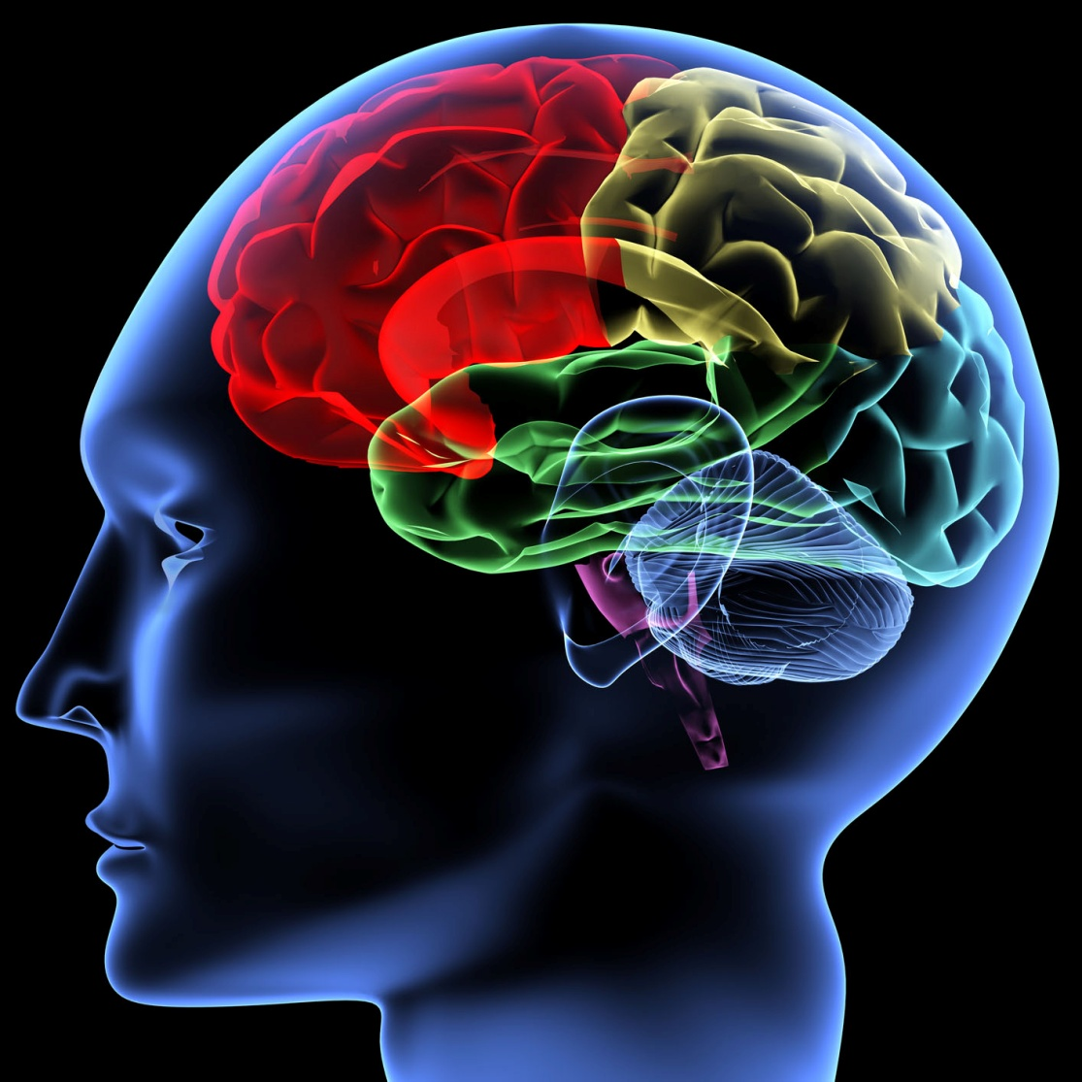
A brief introduction to…
The Human Emotional System

Slide 6
A brief introduction to…
The Human Emotional System
‘How do we feel what we feel?’
‘Why do we do what we do?’
‘What’s this got to do with learning?’

Slide 7
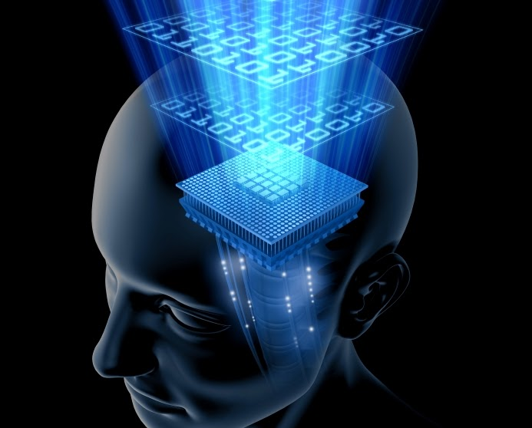
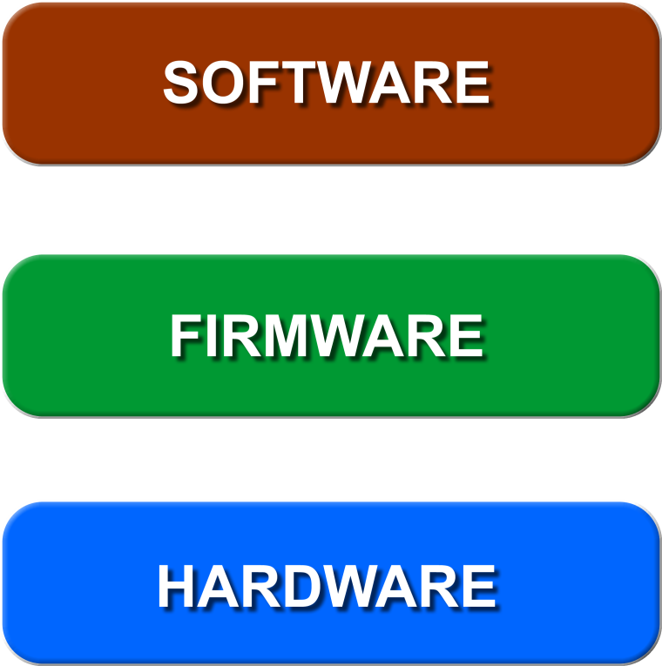

Slide 8
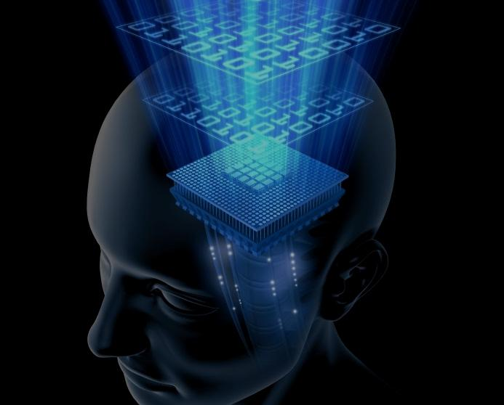
neurons, nerves, muscles, hormones, skin

Slide 9
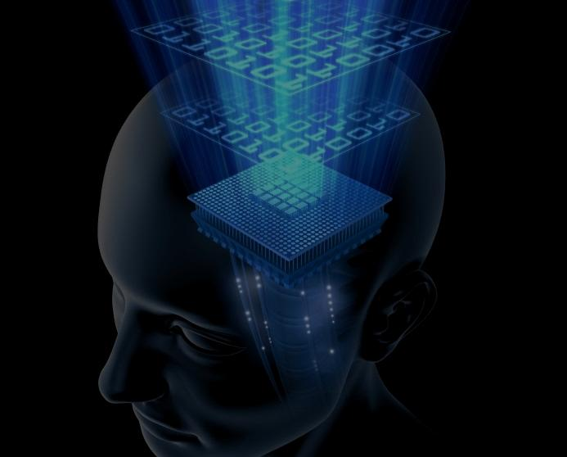
drives, affects
neurons, nerves, muscles, hormones, skin

Slide 10
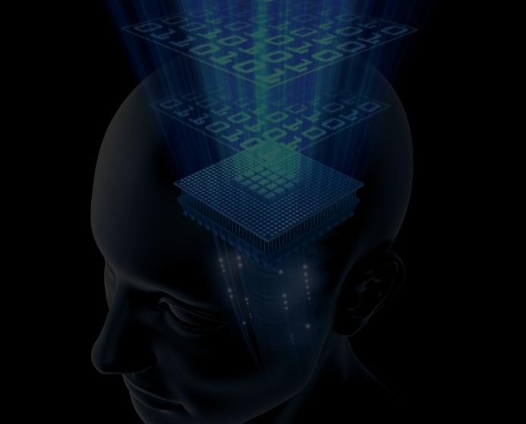
life experience, learning, conditioning
drives, affects
neurons, nerves, muscles, hormones, skin

Slide 11
life experience, learning, conditioning
BIOLOGY
drives, affects
neurons, nerves, muscles, hormones, skin

Slide 12
BIOGRAPHY
life experience, learning, conditioning
BIOLOGY
drives, affects
neurons, nerves, muscles, hormones, skin

Slide 13
BIOGRAPHY
life experience, learning, conditioning
BIOLOGY
drives, affects
neurons, nerves, muscles, hormones, skin
Human emotion is always BIOLOGY + BIOGRAPHY

Slide 14
BIOGRAPHY
life experience, learning, conditioning
BIOLOGY
drives, affects
WHAT OUR BODY SENSES
neurons, nerves, muscles, hormones, skin

Slide 15
BIOGRAPHY
life experience, learning, conditioning
BIOLOGY
WHAT WE SHOULD PAY ATTENTION TO
drives, affects
WHAT OUR BODY SENSES
neurons, nerves, muscles, hormones, skin

Slide 16
BIOGRAPHY
WHAT WE SHOULD DO ABOUT IT
life experience, learning, conditioning
BIOLOGY
WHAT WE SHOULD PAY ATTENTION TO
drives, affects
WHAT OUR BODY SENSES
neurons, nerves, muscles, hormones, skin

Slide 17
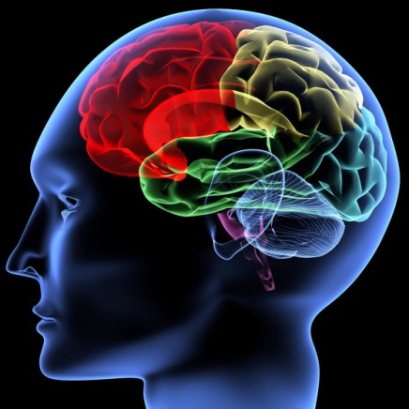

Slide 18
It’s slightly too cold
There’s a slight buzzing sound
My left arm is relaxed
I had cereal for breakfast
This chair is hard
My shirt feels itchy
I don’t follow this story
There’s a breeze on my neck
There’s enough light to see
My blood sugar is slightly low
I can feel my toes in my shoes
I can’t breathe
HARDWARE

Slide 19
It’s slightly too cold
There’s a slight buzzing sound
My left arm is relaxed
I had cereal for breakfast
This chair is hard
My shirt feels itchy
I don’t follow this story
There’s a breeze on my neck
There’s enough light to see
My blood sugar is slightly low
I can feel my toes in my shoes
I can’t breathe
HARDWARE
FIRMWARE

Slide 20
BIOGRAPHY
life experience, learning, conditioning
BIOLOGY
drives, affects
neurons, nerves, muscles, hormones, skin

Slide 21
BIOGRAPHY
life experience, learning, conditioning
BIOLOGY
drives, affects
neurons, nerves, muscles, hormones, skin
STIMULUS

Slide 22
BIOGRAPHY
life experience, learning, conditioning
BIOLOGY
drives, affects
AFFECT
PHYSIOLOGICAL RESPONSE
neurons, nerves, muscles, hormones, skin
STIMULUS

Slide 23
BIOGRAPHY
life experience, learning, conditioning
FEELING
BIOLOGY
drives, affects
AFFECT
PHYSIOLOGICAL RESPONSE
neurons, nerves, muscles, hormones, skin
STIMULUS

Slide 24
EMOTION
BIOGRAPHY
PSYCHOLOGICAL RESPONSE
life experience, learning, conditioning
FEELING
BIOLOGY
drives, affects
AFFECT
PHYSIOLOGICAL RESPONSE
neurons, nerves, muscles, hormones, skin
STIMULUS

Slide 25
WHAT WE DO
EMOTION
BIOGRAPHY
PSYCHOLOGICAL RESPONSE
life experience, learning, conditioning
FEELING
BIOLOGY
drives, affects
AFFECT
PHYSIOLOGICAL RESPONSE
neurons, nerves, muscles, hormones, skin
STIMULUS

Slide 26
Not surprisingly, the Pixar/Disney movie took a little ‘poetic licence’.

Slide 27
Not surprisingly, the Pixar/Disney movie took a little ‘poetic licence’.
Mainly – a little confusion around AFFECTS and EMOTIONS.
AFFECTS ≠ EMOTIONS

Slide 28
Not surprisingly, the Pixar/Disney movie took a little ‘poetic licence’.
Mainly – a little confusion around AFFECTS and EMOTIONS.
AFFECTS ≠ EMOTIONS
AFFECTS EMOTIONS
BIOLOGY
BIOLOGY+BIOGRAPHY

Slide 29
AFFECTS

Slide 30
INTEREST
AFFECTS

Slide 31
INTEREST
ENJOYMENT
AFFECTS

Slide 32
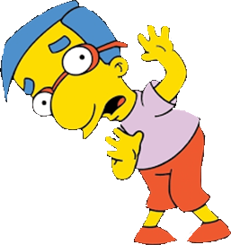
INTEREST
ENJOYMENT
AFFECTS
FEAR

Slide 33
INTEREST
ENJOYMENT
AFFECTS
FEAR
DISGUST

Slide 34
INTEREST
ENJOYMENT
AFFECTS
FEAR
DISGUST
DISTRESS

Slide 35
INTEREST
ENJOYMENT
AFFECTS
FEAR
DISGUST
DISTRESS
ANGER

Slide 36
INTEREST
ENJOYMENT
AFFECTS
FEAR
DISGUST
DISTRESS
ANGER
We are motivated to increase POSITIVE affect,
and to minimise NEGATIVE affect in our lives.

Slide 37
INTEREST
ENJOYMENT

Slide 38
INTEREST
ENJOYMENT
This is what happens when we learn something…

Slide 39
INTEREST
ENJOYMENT
This is what happens when we learn something…
INTEREST… is triggered when we encounter something new, novel
ENJOYMENT… is triggered when we realise that we understand it

Slide 40
INTEREST
ENJOYMENT
This is what happens when we learn something…
INTEREST… is triggered when we encounter something new, novel
ENJOYMENT… is triggered when we realise that we understand it
These makes us FEEL GOOD… and encourage us to continue

Slide 41
INTEREST
ENJOYMENT
This is what happens when we learn something…
INTEREST… is triggered when we encounter something new, novel
ENJOYMENT… is triggered when we realise that we understand it
These makes us FEEL GOOD… and encourage us to continue
But… what happens if we get it wrong… if we don’t understand it?

Slide 42
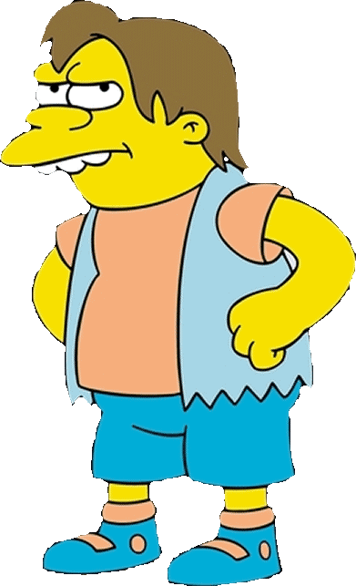
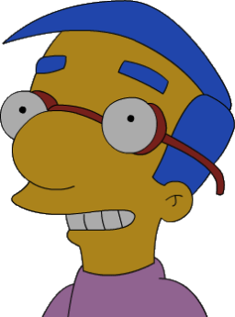
INTEREST
ENJOYMENT
When something (someone) interrupts
our INTEREST or ENJOYMENT…

Slide 43
INTEREST
ENJOYMENT
When something (someone) interrupts
our INTEREST or ENJOYMENT…
We experience a physiological response…
hormones and biochemicals are released,
our head droops,
our shoulders drop,
we look down,
we might blush,
and… our ‘thinking brain’ is momentarily ‘fried’.
SHAME

Slide 44
Whenever anything impedes our experience of
INTEREST or ENJOYMENT…
SHAME affect is triggered.

Slide 45
Whenever anything impedes our experience of
INTEREST or ENJOYMENT…
SHAME affect is triggered.
This is a PHYSIOLOGICAL response.

Slide 46
Whenever anything impedes our experience of
INTEREST or ENJOYMENT…
SHAME affect is triggered.
This is a PHYSIOLOGICAL response.
It is not “feeling ashamed”
I’ve done nothing to be ashamed of.

Slide 47
Whenever anything impedes our experience of
INTEREST or ENJOYMENT…
SHAME affect is triggered.
This is a PHYSIOLOGICAL response.
It is not “feeling ashamed”
I’ve done nothing to be ashamed of.
“Feeling ashamed” is an EMOTIONAL RESPONSE.
it involves our BIOGRAPHY.

Slide 48
Whenever anything impedes our experience of
INTEREST or ENJOYMENT…
SHAME affect is triggered.
This is a PHYSIOLOGICAL response.
It is not “feeling ashamed”
I’ve done nothing to be ashamed of.
“Feeling ashamed” is an EMOTIONAL RESPONSE.
it involves our BIOGRAPHY.
SHAME affect is a purely PHYSIOLOGICAL RESPONSE.
EVERYONE has the same response.
It is a PAINFUL response.

Slide 49
Whenever anything impedes our experience of
INTEREST or ENJOYMENT…
SHAME affect is triggered.
This is a PHYSIOLOGICAL response.
It is not “feeling ashamed”
I’ve done nothing to be ashamed of.
“Feeling ashamed” is an EMOTIONAL RESPONSE.
it involves our BIOGRAPHY.
SHAME affect is a purely PHYSIOLOGICAL RESPONSE.
EVERYONE has the same response.
It is a PAINFUL response.
It what we do when it’s triggered that MATTERS.

Slide 50
WHAT WE DO
EMOTION
BIOGRAPHY
PSYCHOLOGICAL RESPONSE
life experience, learning, conditioning
FEELING
BIOLOGY
drives, affects
AFFECT
PHYSIOLOGICAL RESPONSE
neurons, nerves, muscles, hormones, skin
STIMULUS
SHAME

Slide 51
We all experience the same physiological response whenever the SHAME affect is triggered…
It is PAINFUL.
SHAME

Slide 52
We all experience the same physiological response whenever the SHAME affect is triggered…
It is PAINFUL.
But – its purpose is simply to alert us to the fact that something has interrupted our INTEREST or ENJOYMENT.
SHAME

Slide 53
We all experience the same physiological response whenever the SHAME affect is triggered…
It is PAINFUL.
But – its purpose is simply to alert us to the fact that something has interrupted our INTEREST or ENJOYMENT.
It is PAINFUL to draw our attention to the fact that GOOD THINGS have been interrupted.
SHAME

Slide 54
We all experience the same physiological response whenever the SHAME affect is triggered…
It is PAINFUL.
But – its purpose is simply to alert us to the fact that something has interrupted our INTEREST or ENJOYMENT.
It is PAINFUL to draw our attention to the fact that GOOD THINGS have been interrupted.
It serves a valuable purpose. It provides us with important information.
SHAME

Slide 55
We all experience the same physiological response whenever the SHAME affect is triggered…
It is PAINFUL.
But – its purpose is simply to alert us to the fact that something has interrupted our INTEREST or ENJOYMENT.
It is PAINFUL to draw our attention to the fact that GOOD THINGS have been interrupted.
It serves a valuable purpose. It provides us with important information.
What we do with that information is up to us… and our biography!
SHAME

Slide 56
The helpful, mature response to SHAME affect being triggered is to…
SHAME

Slide 57
The helpful, mature response to SHAME affect being triggered is to…
Take a breath,
Let the physiological response pass,
SHAME

Slide 58
The helpful, mature response to SHAME affect being triggered is to…
Take a breath,
Let the physiological response pass,
and then…
Ask yourself:
SHAME

Slide 59
The helpful, mature response to SHAME affect being triggered is to…
Take a breath,
Let the physiological response pass,
and then…
Ask yourself:
What strategy could I use?
Listen more carefully?
Think it over? Differently?
Ask a question?
Consult the example?
Ask a colleague?
Google it?
etc…
SHAME

Slide 60
The helpful, mature response to SHAME affect being triggered is to…
Take a breath,
Let the physiological response pass,
and then…
Ask yourself:
SHAME
INTEREST

Slide 61
The helpful, mature response to SHAME affect being triggered is to…
Take a breath,
Let the physiological response pass,
and then…
Ask yourself:
SHAME
INTEREST
ENJOYMENT

Slide 62
The helpful, mature response to SHAME affect being triggered is to…
Take a breath,
Let the physiological response pass,
and then…
Ask yourself:
This is what the most successful students have learned
to do automatically whenever they encounter difficulty.
They try a different strategy…

Slide 63
You could train yourself to use the PEACE process:

Slide 64
You could train yourself to use the PEACE process:
Pause, just step back for a moment

Slide 65
You could train yourself to use the PEACE process:
Pause, just step back for a moment

Slide 66
You could train yourself to use the PEACE process:
Pause, just step back for a moment
Exhale, take a deep breath,
let the physiological response pass

Slide 67
You could train yourself to use the PEACE process:
Pause, just step back for a moment
Exhale, take a deep breath,
let the physiological response pass

Slide 68
You could train yourself to use the PEACE process:
Pause, just step back for a moment
Exhale, take a deep breath,
let the physiological response pass
become Aware of how you’re feeling,
and how you’d usually react

Slide 69
You could train yourself to use the PEACE process:
Pause, just step back for a moment
Exhale, take a deep breath,
let the physiological response pass
become Aware of how you’re feeling,
and how you’d usually react

Slide 70
You could train yourself to use the PEACE process:
Pause, just step back for a moment
Exhale, take a deep breath,
let the physiological response pass
become Aware of how you’re feeling,
and how you’d usually react
Choose how you will act this time

Slide 71
You could train yourself to use the PEACE process:
Pause, just step back for a moment
Exhale, take a deep breath,
let the physiological response pass
become Aware of how you’re feeling,
and how you’d usually react
Choose how you will act this time

Slide 72
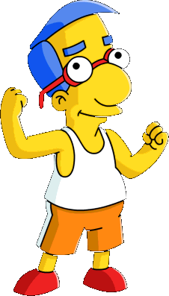
You could train yourself to use the PEACE process:
Pause, just step back for a moment
Exhale, take a deep breath,
let the physiological response pass
become Aware of how you’re feeling,
and how you’d usually react
Choose how you will act this time
Engage again, but differently

Slide 73
You could train yourself to use the PEACE process:
Pause, just step back for a moment
Exhale, take a deep breath,
let the physiological response pass
become Aware of how you’re feeling,
and how you’d usually react
Choose how you will act this time
Engage again, but differently

Slide 74
You could train yourself to use the PEACE process:
Pause, just step back for a moment
SHAME
Exhale, take a deep breath,
let the physiological response pass
become Aware of how you’re feeling,
and how you’d usually react
INTEREST
Choose how you will act this time
Engage again, but differently
ENJOYMENT

Slide 75
When we don’t take the mature path,
we still need a way to deal with the PAINFUL affect…
SHAME

Slide 76
When we don’t take the mature path,
we still need a way to deal with the PAINFUL affect…
There are four, effectively universal, ways we attempt to diminish the PAIN…
SHAME

Slide 77
When we don’t take the mature path,
we still need a way to deal with the PAINFUL affect…
There are four, effectively universal, ways we attempt to diminish the PAIN…
We:
hide to escape the attention
put ourselves down, get in first
divert attention from what’s wrong
put others down
SHAME

Slide 78
When we don’t take the mature path,
we still need a way to deal with the PAINFUL affect…
There are four, effectively universal, ways we attempt to diminish the PAIN…
We:
hide to escape the attention
put ourselves down, get in first
divert attention from what’s wrong
put others down
These four (maladaptive) responses can be arranged to form the
‘Compass’ of Shame
SHAME

Slide 79
‘Compass’ of Shame
WITHDRAWAL
When we WITHDRAW, we:
Avoid eye contact,
Hide in case we’re seen,
Stay quiet in class,
Forget to bring things,
Don’t do homework,
Don’t ask questions,
Don’t answer questions,
Stay away from class
Stay away from school
Don’t try
When we don’t try,
we can’t fail

Slide 80
‘Compass’ of Shame
WITHDRAWAL

Slide 81
‘Compass’ of Shame
WITHDRAWAL
When we ATTACK SELF, we:
Trash talk ourselves,
Think we can’t do it,
Think we’ll never get it,
Put ourselves down,
Let others put us down,
Expect to fail,
Don’t ask questions,
Don’t try
When we don’t try,
we can’t fail
ATTACK SELF

Slide 82
‘Compass’ of Shame
WITHDRAWAL
ATTACK SELF

Slide 83
‘Compass’ of Shame
When we AVOID, we:
Pretend it’s not important,
Focus on other strengths,
Get caught up in things,
Take risks to show off,
Don’t do homework,
Don’t ask questions,
Don’t come to class,
Don’t try
When we don’t try,
we can’t fail
WITHDRAWAL
ATTACK SELF
AVOIDANCE

Slide 84
‘Compass’ of Shame
WITHDRAWAL
ATTACK SELF
AVOIDANCE

Slide 85
‘Compass’ of Shame
When all else fails, we try to make ourselves feel better by ATTACKING OTHERS.
We:
Sledge, pay out on others,
Call them names, exclude,
Use derogatory nicknames,
Ridicule, bully, troll,
Find fault with the work,
Find fault with colleagues,
Find fault with the teacher,
Physically harass,
Don’t try
When we don’t try,
we can’t fail
WITHDRAWAL
ATTACK OTHER
ATTACK SELF
AVOIDANCE

Slide 86
‘Compass’ of Shame
WITHDRAWAL
ATTACK OTHER
ATTACK SELF
AVOIDANCE

Slide 87
‘Compass’ of Shame
WITHDRAWAL
ATTACK OTHER
ATTACK SELF
AVOIDANCE
Each of these ‘Compass’ Strategies might lessen the pain temporarily…
… but none of them help, or go any way towards resolving the issue that caused the pain.

Slide 88
The helpful, mature response to SHAME affect being triggered is to…

Slide 89
The helpful, mature response to SHAME affect being triggered is to…
Take a breath,
Let the physiological response pass,
and then…
Ask yourself:
SHAME
INTEREST
ENJOYMENT

Slide 90
You could train yourself to use the PEACE process:
Pause, just step back for a moment
Exhale, take a deep breath,
let the physiological response pass
become Aware of how you’re feeling,
and how you’d usually react
Choose how you will act this time
Engage again, but differently

Slide 91
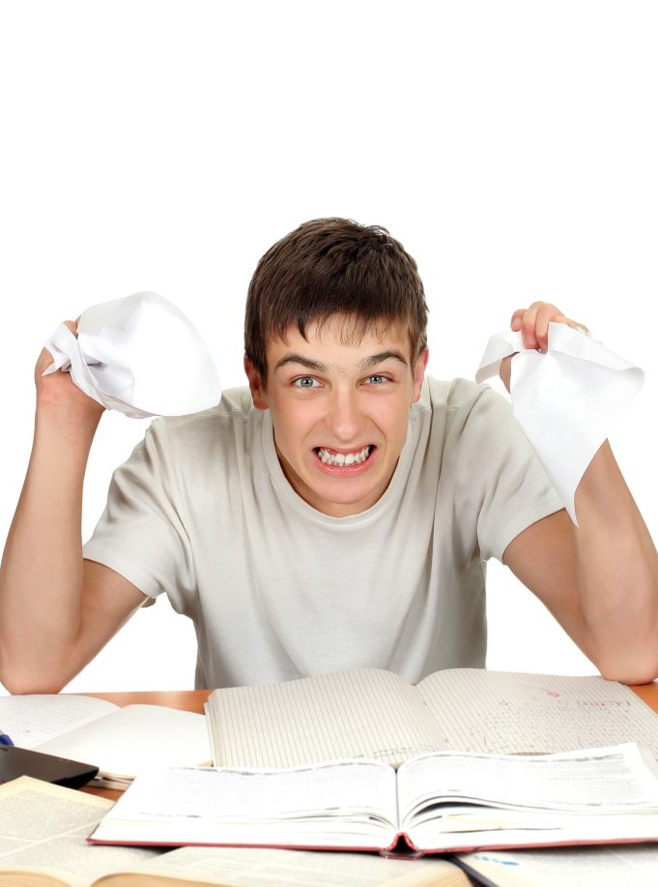
The ‘bottom line’…
Learning will involve difficulty, frustration and confusion…
This is inevitable in learning anything worthwhile…
These hurdles will trigger SHAME affect…

Slide 92
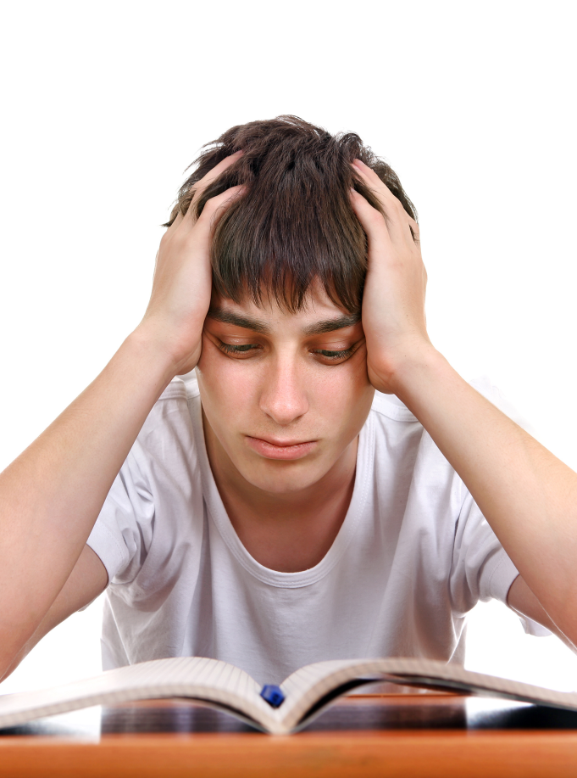
The ‘bottom line’…
Learning will involve difficulty, frustration and confusion…
This is inevitable in learning anything worthwhile…
These hurdles will trigger SHAME affect…
It’s what you do when the SHAME is triggered,
that makes all the difference

Slide 93
SHAME
The ‘Compass’ of Shame Strategies
The Expert Learner Approach
WITHDRAWAL
ATTACK OTHER
The PEACE process
ATTACK SELF
AVOIDANCE
What strategy could I use?
Listen more carefully?
Think it over? Differently?
Ask a question?
Consult the example?
Ask a colleague?
Google it?
etc…

Slide 94
You can become an
EXPERT LEARNER
by…
Being more aware of your emotions and how they affect your work and study.
Practising strategies (like PEACE) to overcome learning shame when it occurs, and get yourself back on track.
Not falling for ‘Compass’ of Shame responses – that don’t achieve anything.
Learning from your mistakes.

